Slide 1
Object Oriented Programming using C++
Shivank Pathak
Aman Kumar Gupta

Slide 2
Layout of today’s session:
Common Programming paradigms.
Why Object Oriented Programming?
Features of object oriented programming
Basic Syntax

Slide 3
Common Programming Paradigms
Procedural Programming (functions)
Modular Programming (namespaces)
Object Oriented Programming (classes)
Generic Programming (templates)

Slide 4

So many programming paradigms!!!

Slide 5
We will not discuss all of these!!!
In the last two sessions we have used procedural programming.
And STL libraries that we have used are implemented using Generic Programming.

Slide 6
Procedural Programming
A program is a list of instructions
Concentration is on what is to be done?
Problems created by global data
No access control !!

Slide 7
Object Oriented Programming
As the name suggests, It uses Object in programming.
Example of OOPs languages: C++,java,python
But What is object???

Slide 8
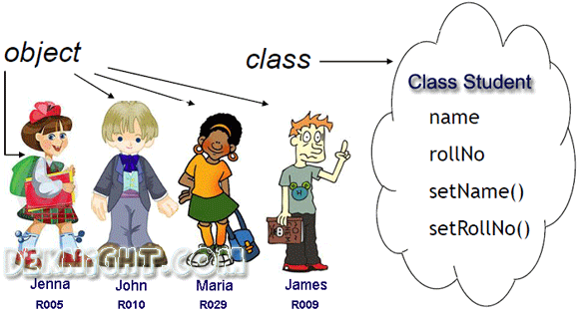
Object is any real life entity

Slide 9

Features of OOPS:
Encapsulation
Data Abstraction
Polymorphism
Inheritance

Slide 10
Encapsulation
Wrapping up of data and functions into a single unit(Class) is known as encapsulation.
The data is not accessible to the outside world and only those functions which are wrapping in the class can access it. This insulation of the data from direct access by the program is called data hiding.

Slide 11
Data Abstraction
Data abstraction refers to providing only essential information to the outside world and hiding their background details, i.e., to represent the needed information in program without presenting the details.

Slide 12
Polymorphism
> Polymorphism means ability to take more than one form.
> An operation may exhibit different behaviors in different instances. The behavior depends upon the types of data used in the operation.

Slide 13
Inheritance
> Inheritance is the method with which a class can inherit the properties of any other class.
> Here properties refers to any variables or functions. ( you’ll code these things in the later slides)

Slide 14
What all can we keep inside a class?
> Variables(In OOP it is called as Data Members).
> Functions(In OOP it is called as Member Functions).
> Objects. (Not the object of the same class)

Slide 15

How to create a class and use it?
For this, let’s get down to business.

Slide 16
But before that, we need to get acquainted with some Access Modifiers of Class:
> Private: Under this modifier, variables and functions can’t be accessed by objects directly.
> Public: Open to all.
> Protected: Similar to private, but have some differences in inheritance (we won’t be focussing towards it in this session).

Slide 17
Class definition
class person
{
char name[20];
int id;
public:
void getdetails(){}
};
int main()
{
person p1; //p1 is a object
}

Slide 18
Oh gosh!!! So many things :’(
Don’t worry, we’ll cover only basics of OOPs in this session.
> What are classes and objects, and how to create them?
> What all can we keep inside class?
> And most importantly, how does it work?
> Relation between STLs and, class and objects.
> Build our own library.

Slide 19
What is a class?
Class is a blueprint for any functional entity which defines its properties and its function. Like Human Being, having body parts, and performing various actions.
When you define a class, you define a blueprint for an object.This doesn’t actually define any data, but it does define what the class actually name means, that is, what an object of the class will consist of and what operations can be performed on such an object.

Slide 20
How does classes and objects work?
Class doesn’t take any space. It is a user defined data type.
It is of no use if don’t create any object.
For eg., There is an almirah (Class) which is locked, you can’t use anything from inside it unless you have a key(object).

Slide 21
Relation between STLs and, classes and objects
Remember this syntax?
vector<int> vec;
> Vector is a class and vec is its object.
vec.erase(3);
> erase() is a function inside the vector class and we are using it through vector’s object, i.e. vec

Slide 22
Wanna build your own cool library?
But before that, a common practice in building C++ libraries, and in any general C++ development:
> Keep class definitions and usage in different files.
> Class definition files are known as header files (my_library.h) and the usage files are kept as cpp files (my_file.cpp)
> For example, vector is a class and has all its functions inside it. You just use it in your cpp file. You don’t need to code explicit functions for vector.

Slide 23
Ready, set and build!
Let’s get started and do some practical.

Slide 24
OOPs doesn’t end here.
> Remember, yesterday we said in the last slide that, the STL you saw yesterday wasn’t even close to 5% ?

Slide 25


Now you know, STL is built with OOPs techniques.
So imagine how vast and in-depth topic Object Oriented Programming might be!

Slide 26

Wanna proceed in development with C++, OOPs + STL is a must!

Slide 27
















